Slide 1
Integrated Pest Management (IPM) in the School Setting: Strategies for Protecting Children from Exposure
Janet Hurley, MPA and Mike Merchant, PhD
Texas AgriLife Extension Service School IPM Program

Slide 2
Integrated pest management
It’s not just pest control but a way to think and react to everyday actions.
IPM is about roaches, rats, ants, bats, birds, weeds and more.
IPM is also about maintaining the school building so it’s safe for teachers and students.
IPM is a about people working together.

Slide 3
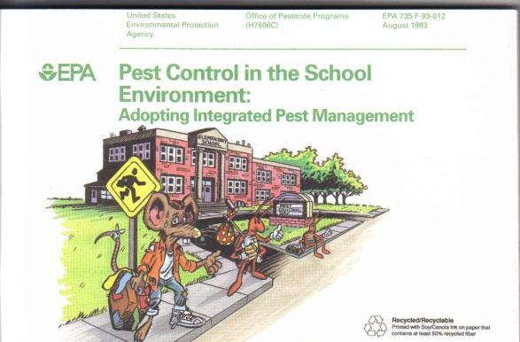
History of School IPM
U.S. EPA “introduced” school IPM in early 1990s
  Grants were provided to land grant institutions to develop materials to help schools understand a different way to control pest.
Regional IPM Centers founded to promote better adoption of IPM and research better solutions to problems in 1999.
  Regional IPM Centers began promoting school IPM research in the new millennium

Slide 4
History of School IPM
Texas & Michigan were first to Adopt School IPM Mandates – 1991 and 1992
To date there are 39 states with some form of regulation or mandate that either requires or requests schools to follow IPM guidelines.
Federal Legislation - School Environment Protection Act (SEPA) was introduced into Congress in 1999, but it has never succeeded as states prefer local control, rather than Federal.

Slide 5


EPA & USDA
United in encouraging schools to adopt school IPM.
Have developed a national strategic plan to have every school practicing school IPM by 2015.
You can help this goal by understanding your role in Integrated Pest Management Program in your School.

Slide 6
IPM Defined
IPM is a strategy using multiple control tactics to ensure that:
  pest populations are managed at acceptable levels
  risks to people, other non-target organisms and the environment are minimized
  the pest control program is practical and economical
Notes:
6

Slide 7
How is IPM different?
IPM focuses on safe and effective ways to control pests
Delicate balance between pests & pesticides
Multiple tactics proven most effective
Thresholds and monitoring ensure pesticides are used only when necessary
Routine inspections & monitoring are essential – routine spraying is not.

Slide 8
Essential Ingredients for an IPM Program
IPM Coordinator
IPM Policy
Employee Involvement
  Pest management is people management
Inspections and monitoring
Pest identification
Managed Treatments
  Using action thresholds
  Use of multiple control tactics
Education
Notes:
8

Slide 9
IPM Coordinator
Is the designated person responsible for overseeing the day to day pest problems.
Is also responsible for maintaining the building structure so that pests can’t move into the building.
This person often wears many hats and relies on school employees to help with reporting building repairs or pest problems.
This person also ensures that advance notice of pesticide treatments is posted in the area that is to be treated.
  For more information regarding this policy please contract your local coordinator for more information

Slide 10
IPM Policy Statement
Should detail the districts intent towards IPM and what guidelines they will follow.
Should have statements about monitoring, inspections, establishing thresholds, who can apply pesticides, how problems should be reported, and who should be educated about the program.
Should be adopted by the School Board to set a standard for the district
Additional areas for IPM to be successful
  Work with the pest management professional to draft pest management plans.
  Adopt an IPM (IAQ) committee to meet periodically to discuss environmental issues for the district.
  Educate teachers, custodians, food service, maintenance and grounds workers about their role in IPM.
Notes:
A policy statement for school pest management should state the intent of the school administration to implement an IPM program. It should briefly provide guidance on what specifically is expected--the incorporation of existing services into an IPM program and the education and involvement of students, staff, and pest manager.

Slide 11
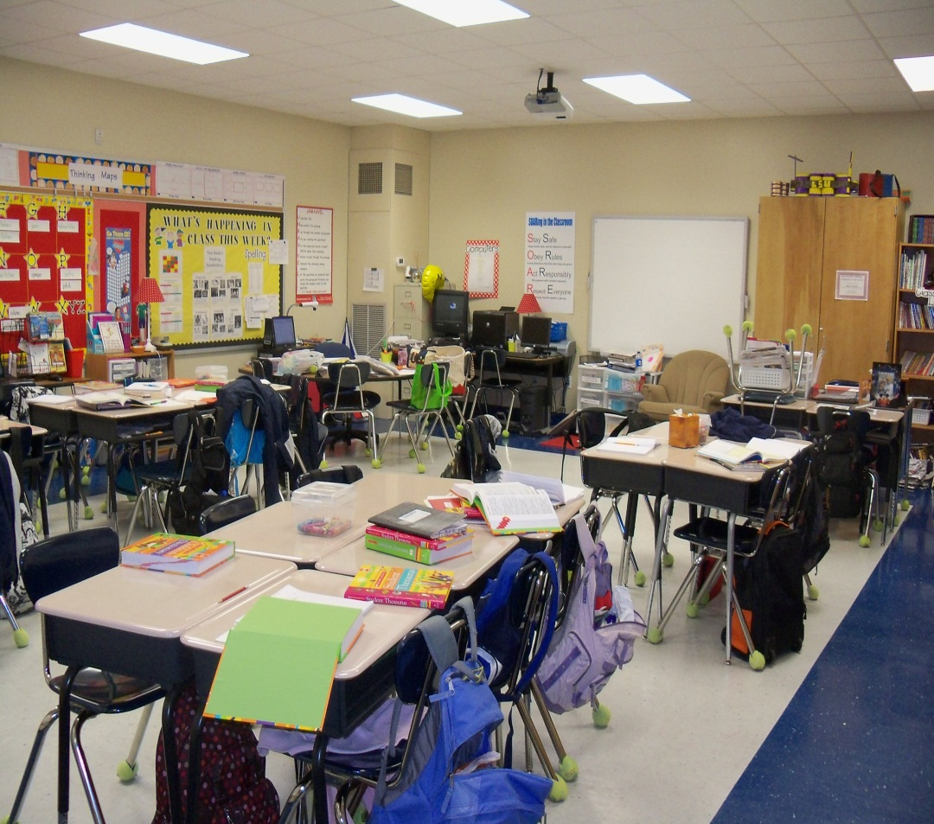
Employee Involvement
Remember IPM is everyone’s Job!
Everyone has a role to play when it comes to IPM
  Report broken doors, leaky faucets, cracked windows.
  Pick up clutter in your room
  Don’t leave food, crumbs, candy and other items around.
  Store food items in locking plastic containers
  Report food and drink spillages when they occur.
Notes:
It's important to remember that no matter who you are in the district you have a vital role in the IPM program. Teachers remember students can bring pests in from home, alert your coordinator to this potential pest problem. We all need food to survive; however, cockroaches and ants only need crumbs so that candy bar or cookie you just ate and dribbled on the ground, just became dinner for the next bug.
Clutter is the best friend to roaches and mice, if you can’t see the walls of your classroom, think about what clutter you can eliminate. Can you store your supplies in a large locking container?

Slide 12
Inspections
Simple
  These types of inspections are often conducted by the pest control company or licensed pesticide applicator
    Done on a monthly basis
Intense
  Reviews the entire building integrity looking for pest entry ways or hiding places
    Done annually or every other year based on age
New issue
  Complaint comes in to a non-monitored area
  Critical for public health pests
Notes:
Simple inspections look at specific areas on a school campus that are generally high for pest threats. Kitchens, cafeterias, teacher lounges, locker rooms and other rooms with food or water are general inspected on a routine basic. General assignment areas like offices or classrooms generally are not monitored on a routine basis, unless the teacher suspects a pest problem.
Intense inspections are conducted by the coordinator or their staff to look at the building’s overall maintenance. Annual IPM inspections look for entry ways outdoors that are the size of a dime or larger and patch them up. Annual inspections also look for conducive conditions for rats, ants and roaches to hide. Inspectors look for evidence of bird nests located on the school building, so if you see birds nesting on school property, turn that pest problem in. Intense inspections also review the interior of a campus looking for pest hiding places in classrooms, custodial closets, food storage areas, and any where else bugs and rodents like to hide.
New issue, depending on the pest complaint and the pest, the IPM coordinator will inspect that area for the pest problem. Solutions may include sanitation (cleaning up the area), removal of food stuffs, vacuuming or disinfecting of the area, monitoring using a glue board – sticky trap, and possibly use a low-impact pesticide. Remember under IPM that last tool is a can of pesticide – IPM looks at what pests need to survive and then eliminates them to ride you of pests forever.

Slide 13
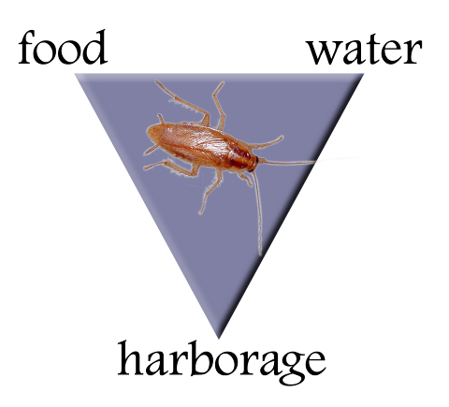
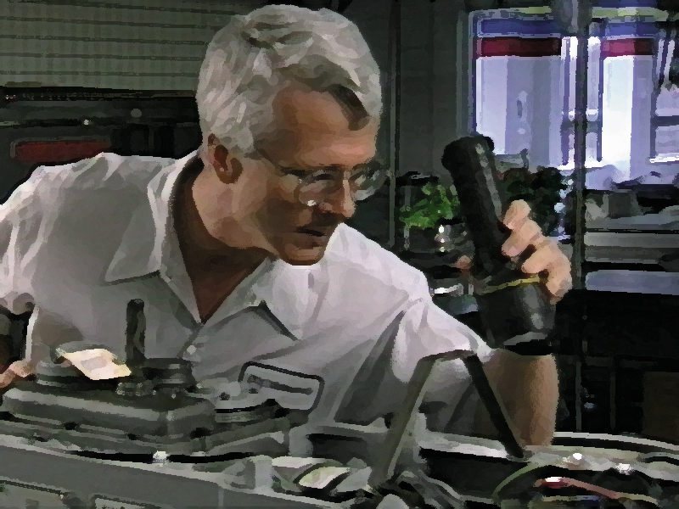
What is an IPM inspection?
Goes beyond sanitation
Looks for critical things pests need
  food
  water
  temperature
  harborage
The pest triangle
Notes:
13
Remember IPM looks for harborage areas

Slide 14
What is an IPM inspection?
Reduce a “requisite” - reduce a pest
Sanitation, not pesticides will control pests
The pest triangle
Notes:
14
If you can take away where bugs and mice like to hide, you can reduce your chance in coming in contact with them. Remember you can control the environmental you teach, cook, clean or repair everyday.

Slide 15
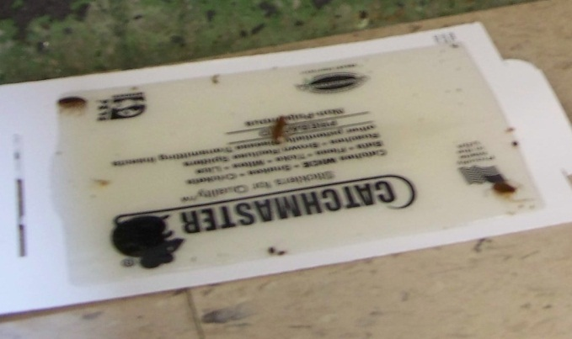
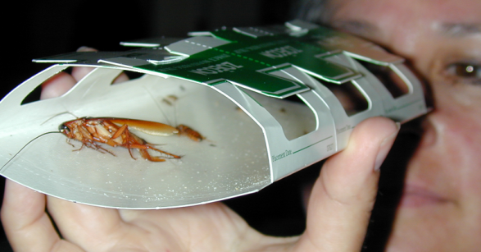
Monitoring
Monitoring/sampling
  Monitoring - sampling over time to observe trends and changes in pest activity
  Uses a simple device (glueboard, sticky trap)
  Sampling - observing and recording pest presence or numbers
    Trap checking to see if control measures are working or not.

Slide 16
Reporting
Pest sighting logs
  Notebooks placed with food service and campus secretary
Work orders
  Online system to report pest complaints and building problems
Contact IPM Coordinator
  Designated person of contact
Report to secretary, head custodian, others
  Someone who can contact building services for notification of problem.

Slide 17

IPM pyramid
Pesticides
Mechanical controls (traps, barriers)
Physical controls (heat, light, cold)
Education/Awareness
Pest proofing/Sanitation
Notes:
The proper response to IPM is to inspect the problem and then look at what actions need to be taken. The hierarchy of the pest control response is to look at preventing the pest from coming back to looking at the general sanitation. Does additional cleaning need to be taken, was old food left forgotten, how much clutter is in the classroom?
In some cases we can solve the pest problem using a physical or mechanical controls. For some pests the use of glue boards, insect light traps or snap traps can control several pests. In other cases, changing the timing on security lights, installing weather stripping, sealing up holes and cracks can help control pests.
Biological controls are a way to eliminate pests using a predator to kill the pest. For example, soil is sometimes contaminated with a fungus gnat a long term way to rid the soil of the gnat is to use a beneficial nematode to strengthen the soil to resist the gnat growth.
Finally, when everything else has been resolved pesticides are used to control the pest. In some cases, pesticides may have to be used often to control the pest. However, in most cases containerized baits, gels that are placed into crack and crevices can be used to solve today’s pest problems.

Slide 18
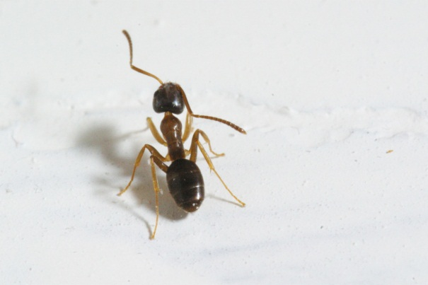
Common Pests in Schools
Cockroaches:
  Skin fragments and feces are the most common cause of asthma in urban youth.
  They are also responsible for transmitting several food born illnesses
Ants:
  Fire ant stings cause several human deaths per year.
  Several ant species can invade electrical equipment
Notes:
Other pests that often plague schools are head lice, termites, spiders, bees, wasps, and much more.

Slide 19
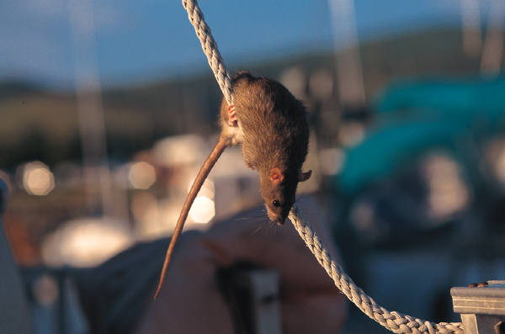
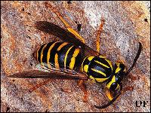
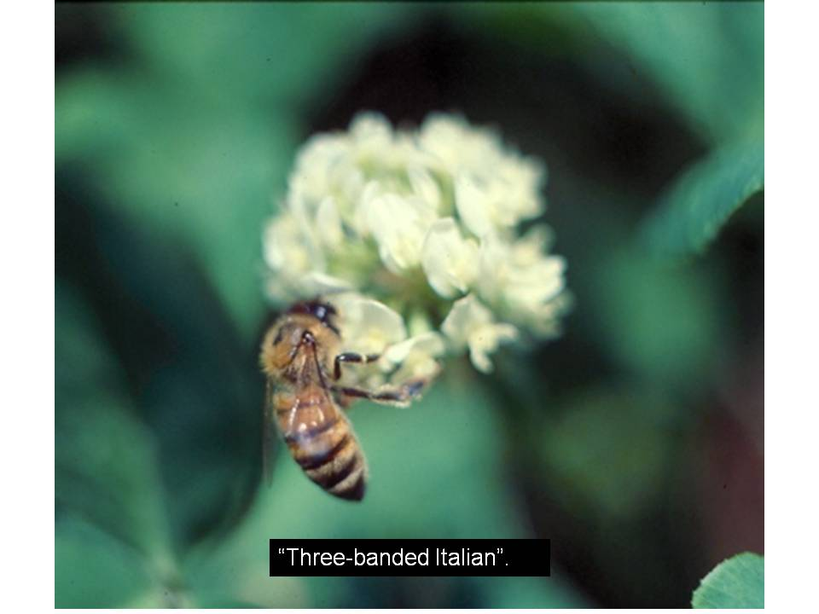
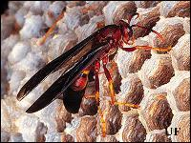
Common Pests in Schools
Rodents:
  Deadly hantavirus is transmitted by rodent urine and feces
  Transmits several food born illnesses
  Has been linked to plague thru fleas
Bees & Wasps
  Stings can cause allergic reaction
  Rapid development of nest in some cases overnight
Notes:
Other pests that often plague schools are head lice, termites, spiders, and much more.
Bee and wasp images – yellowjacket top, honey bee middle, paper wasp bottom

Slide 20
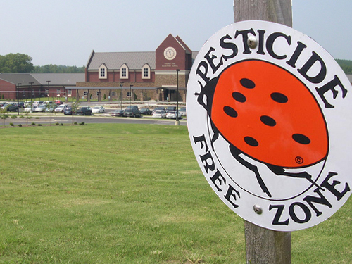
Forces affecting IPM today
School/Community IPM Initiatives
LEED buildings
Certification programs
Clean Water Act
Bed bugs
Insurance – Termite warranty work

Slide 21
Bed Bugs
What to do if you encounter this pest at your school

Slide 22
Bed bug IPM:
A brief overview
Michael Merchant, PhD, BCE
Texas AgriLife Research and Extension Center at Dallas

Slide 23
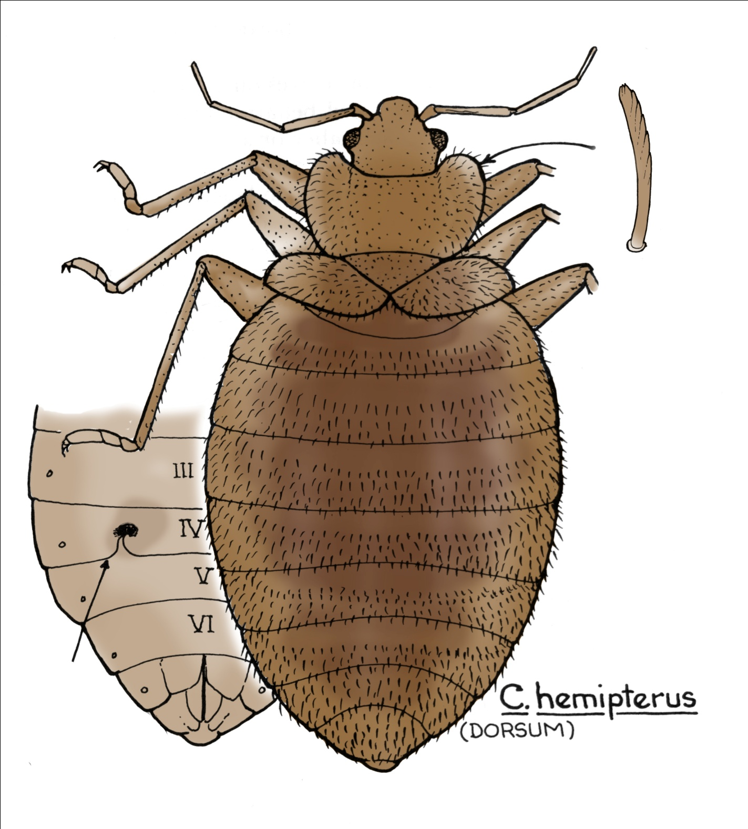
Identification
4-5 mm-long (size of apple seed),
mahogony-colored, wingless, flattened
Pronotal bristles toothed (microscopic)

Slide 24
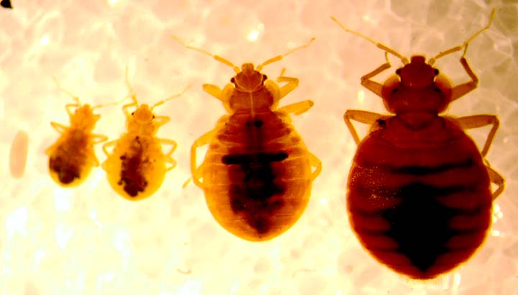

Slide 25
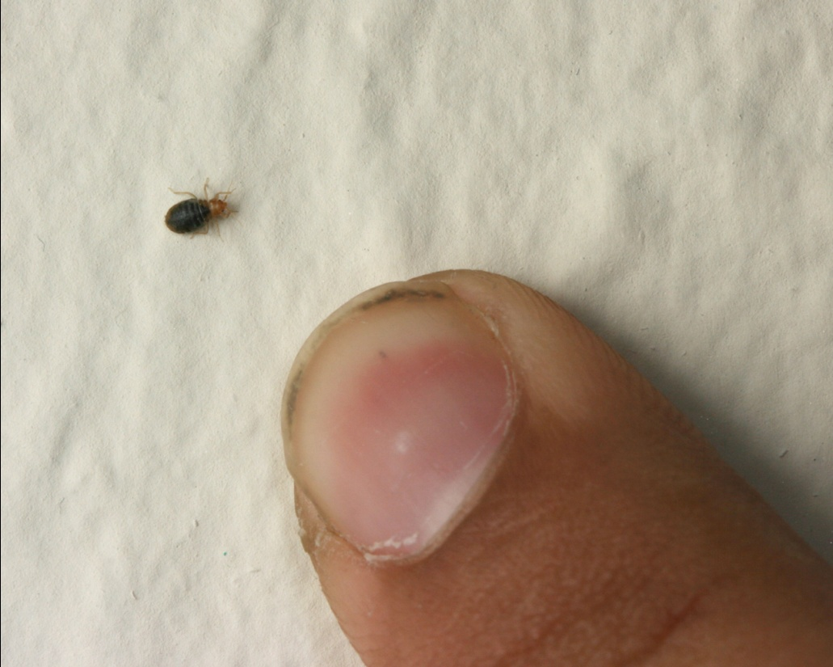
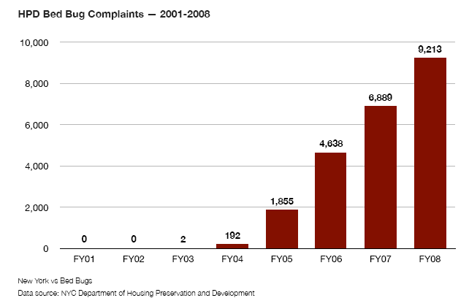
Bedbugs
Photo by M. Merchant
Infestations increasing nationwide
Adults approx. 3/16 inch-long
Hide in cracks and crevices during day
Previously fed adults can survive 6-7 months without human host
Must feed on blood from humans, pets, birds or bats

Slide 26

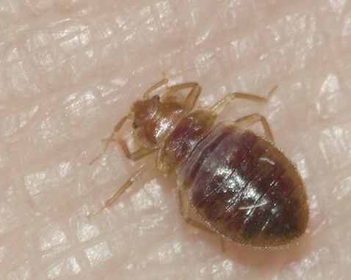
Bed bug feeding habits
Prefer feeding during darkness
Bites painless
50% of people with bed bug infestations may not know they are being bitten
High risk of infestation moving from one apartment to adjacent apartment

Slide 27
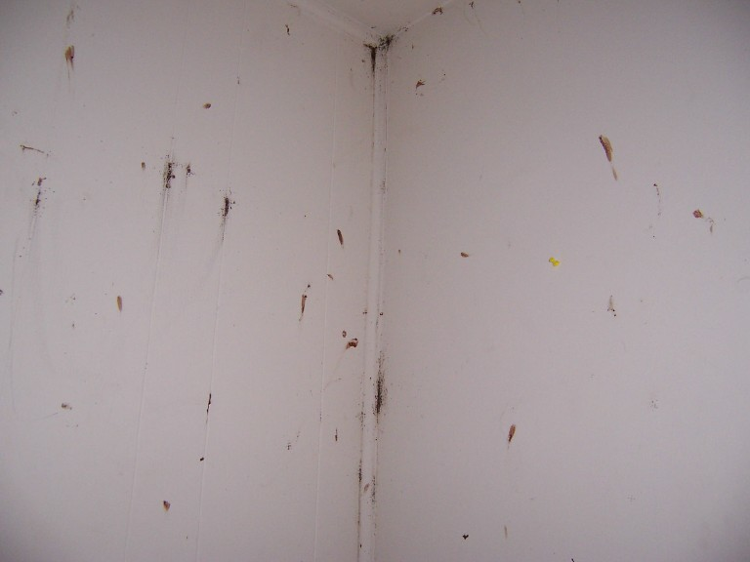
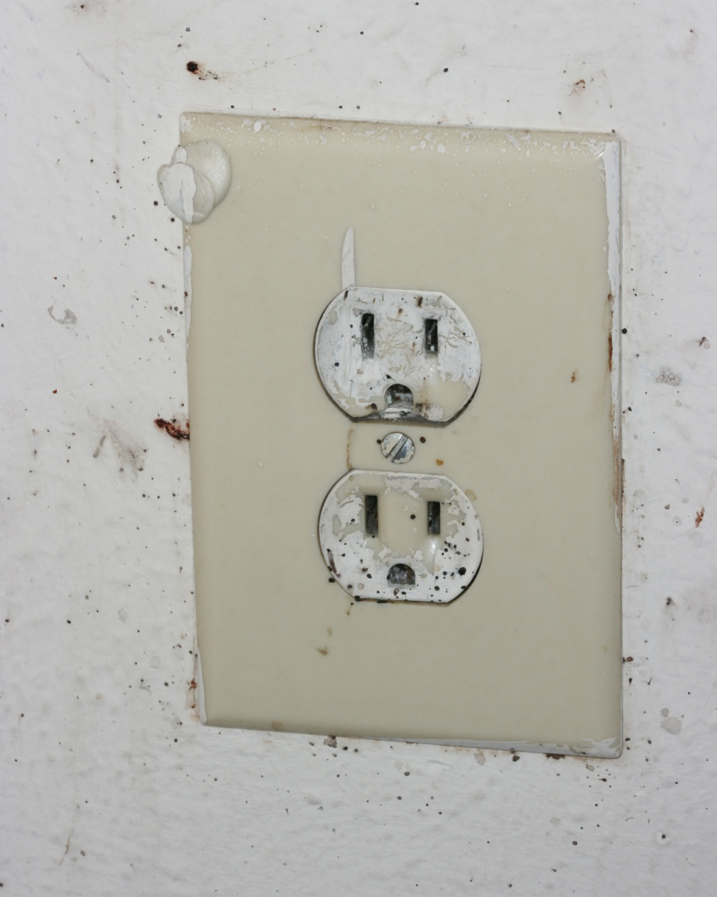
Photo by M. Merchant
Notes:
This picture shows bed bugs and bed bug feces along the molding and behind where posters had been hung in a heavily infested apartment. The smears on the wall are where the residents attempted to crush the insects. Bed bugs may be found throughout rooms where people sleep and may move from one apartment to the next via wall voids.
Fecal specks, like those seen on this electrical outlet, are a good clue to the presence of these insects in an infested room. Vacuuming, encasement of mattresses, and a thorough and careful crack and crevice treatment with appropriate pesticides is needed to eliminate such infestations.

Slide 28
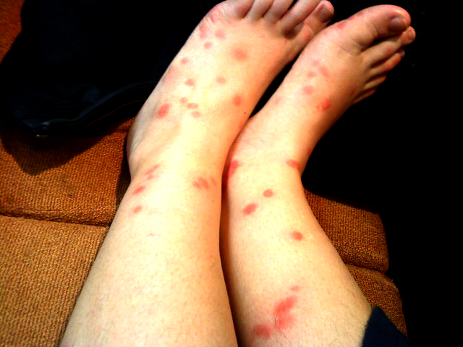
Photo by clairebelles, courtesy Flickr

Slide 29
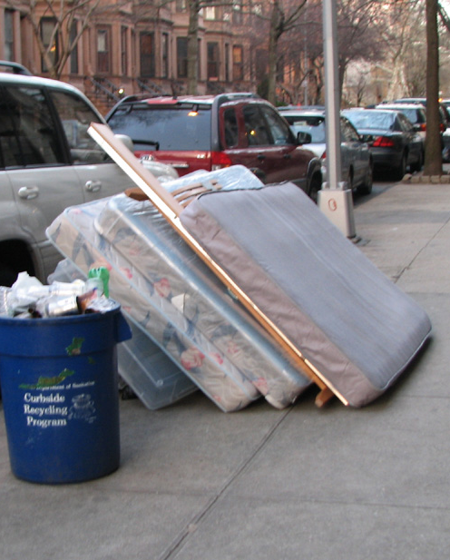
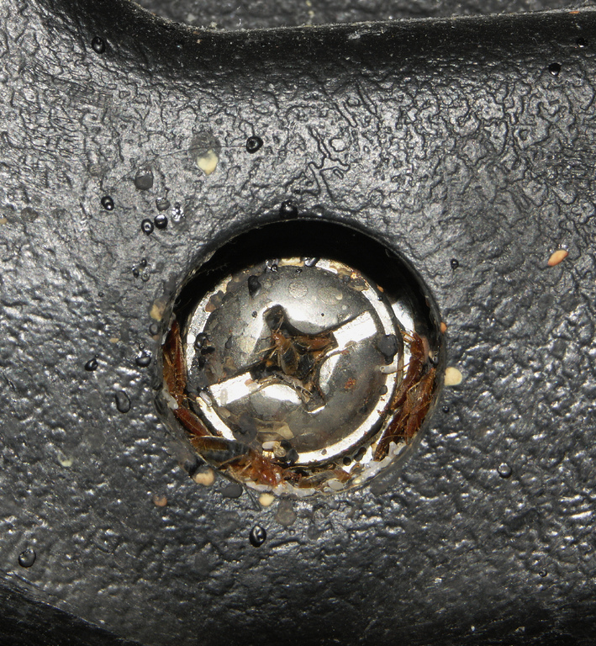
Challenges with bed bugs
Hiding places diverse
  50% on or around bed
  Upholstered chairs, sofas, nightstands, dressers, other furniture
  Baseboards, under carpet tack strip, any small cracks, behind posters, clocks, etc.
Replacing mattress more a problem than a solution
  Mattress and box spring encasements the answer
Family of bed bugs around recessed screw in plastic office chair

Slide 30
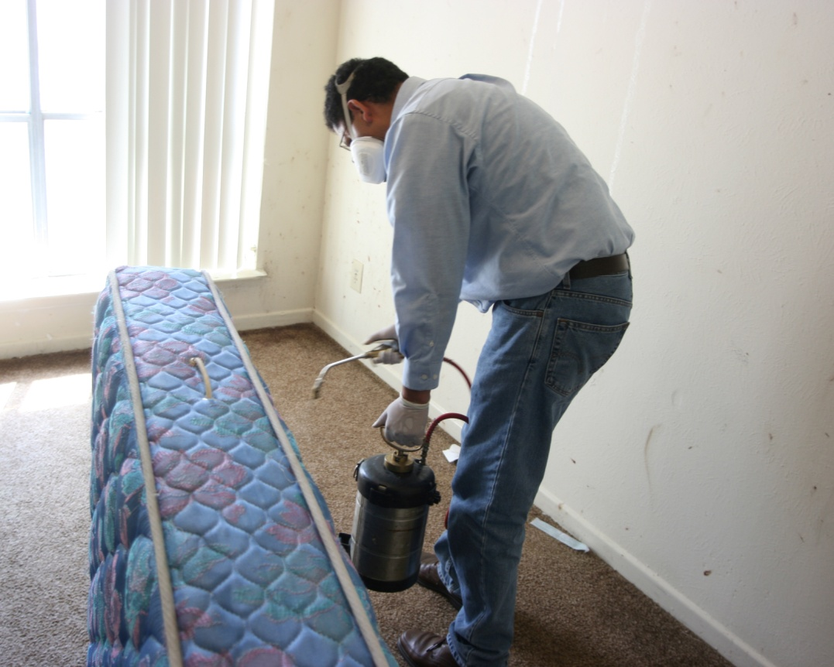
Challenges with bed bugs
Control expensive
  Labor-intensive
  Success highly dependent on customer cooperation
  Cleaning infested clothes
    Freeze 10-12 hours min.
    Hot-setting on drier 30 min.
    Hot wash 30 mins. (140º)
    Dry cleaning effective
  Pesticides not highly effective

Slide 31
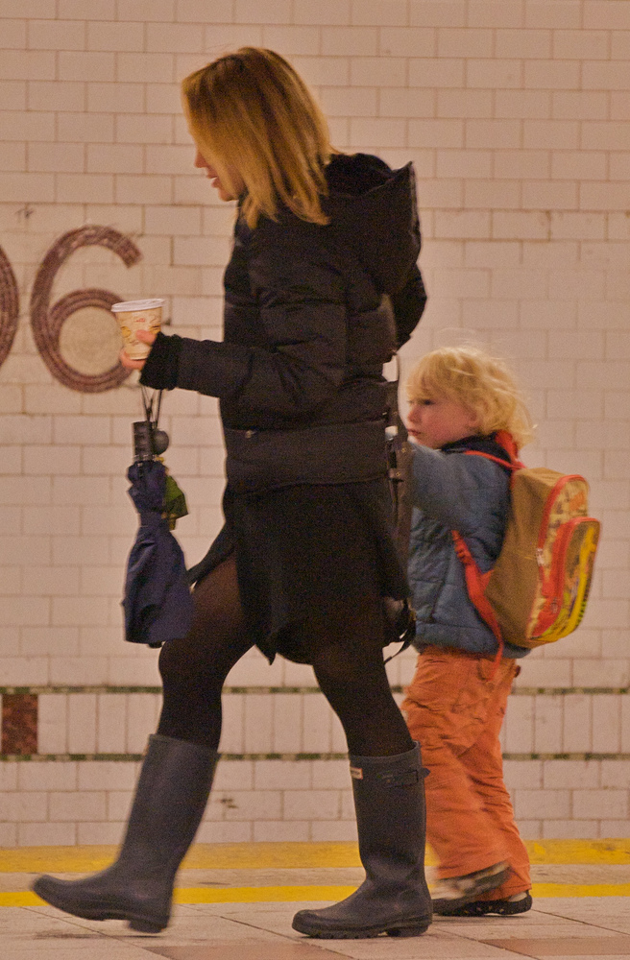
Challenges with bed bugs
Bed bugs are excellent hitchhikers
  Suitcases
  Clothing
  Backpacks
Bed bugs are good runners
Photo by Ed Yourdon, Flickr

Slide 32
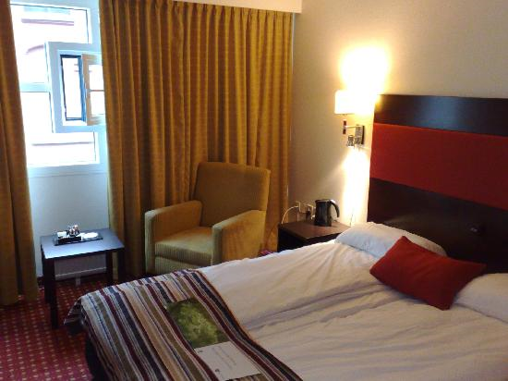
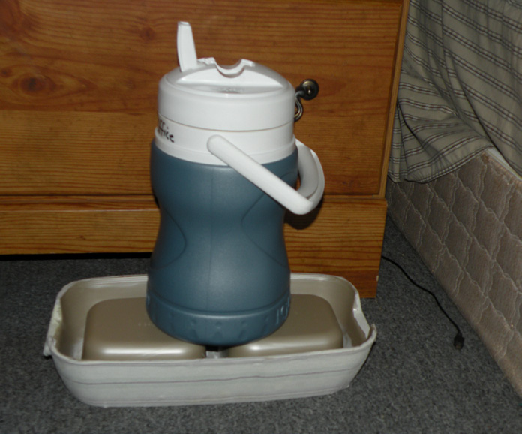
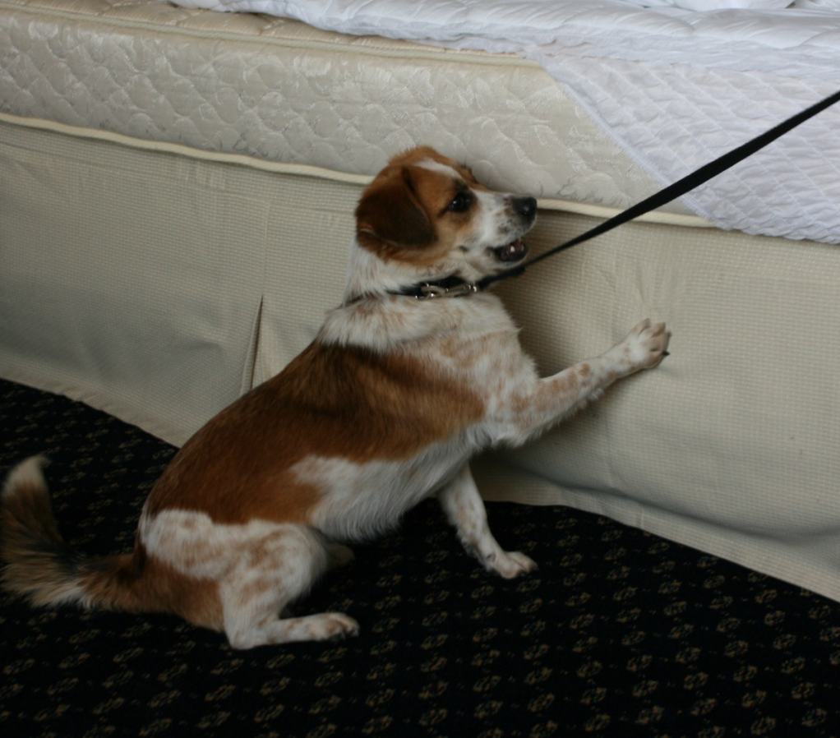
Monitoring and detection
Look for fecal specks and bugs around beds
  Headboards in hotels
  Mattresses in homes
Sticky cards not very effective
CO₂ traps becoming more useful
New passive monitoring traps
Dogs

Slide 33
More Information
Texas AgriLife School IPM Program
  http://schoolipm.tamu.edu
  http://Citybugs.tamu.edu
National School IPM Information Source
  http://schoolipm.ifas.ufl.edu/
US EPA – Healthy Schools
  http://cfpub.epa.gov/schools/index.cfm
IPM Centers
  http://www.ipmcenters.org/
IPM Institute of North America
  http://www.ipminstitute.org/

Slide 34
Contact Information
Janet Hurley, MPA – Extension Program Specialist II
School IPM Texas AgriLife Extension Service
Southwest Technical Resource Center
17360 Coit Road, Dallas, Texas 75252
Phone: 877-747-6872 or 972-952-9213
Fax: 972-952-9632
Email: ja-hurley@tamu.edu
Facebook: http://facebook.com/SchoolIPMTexas
Michael Merchant, Ph.D., BCE
Professor and Extension Urban Entomologist
Texas AgriLife Research and Extension Center
17360 Coit Road, Dallas, Texas 75252
Phone: 972-952-9204
Email: m-merchant@tamu.edu
Website: http://citybugs.tamu.edu
Shannon Cox, MS, CHES
Health Education Coordinator III
Southwest Center for Pediatric Environmental Health
University of Texas Health Science Center Tyler
11937 US Hwy 271, Tyler, Texas 75708
Phone: 888-901-5665 or 903-877-5045
Fax: 903-877-7982
Email: shannon.cox@uthct.edu
Website: www.swcpeh.org
Janie Fields, MPA
Executive Director
Children’s Environmental Health Institute
3000 B. Island Way, Austin, Texas 78746
Phone: 512-657-7405
Email: janie.fields@cehi.org
Website: www.cehi.org

Slide 35
Contact Information
Monique Mills, MD
Associate Professor or Pediatrics
University of Texas Health Science Center Tyler
11937 US Hwy 271, Tyler, Texas 75708
Phone: 903-877-5941
Email: monique.mills@uthct.edu
Website: www.uthct.edu
Healthy School Network Inc.
773 Madison Avenue, Albany, New York 12208
Phone: 518-462-0632
Fax: 518-462-0433
Website: www.healthyschools.org
www.nationalhealthyschoolsday.org
Playback Link for Webinar:
https://sas.elluminate.com/mr.jnlp?suid=M.643CA475977D25AEE8E6DC7AE14C1F&sid=2009292
Will be available for 5 business days to view

