Slide 1
What every TX teacher needs to know about their school garden setting
Janet hurley,
Extension Program Specialist II
school ipm
Texas agrilife Extension Service
Ja-hurley@tamu.edu
972-952-9213

Slide 2
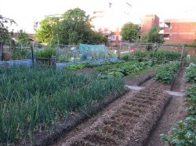
Pesticide Sprays: Not in My School Garden, Say Iowa Parents
“However, one item threatens to upset the entire green operation — rogue pesticides sprayed on a nearby lawn.”
Notes:
School gardens are becoming more desired on school campuses to help teach children where food comes from, help reduce obesity by teaching healthy eating and living skills and basic math and science skills. However, these gardens can often lead to hidden problems by community members, school employees and parents not knowing state pesticide rules and general pesticide safety precautions. Gardens used to grow food for consumption require more strict adherence to insecticide and herbicide applications.

Slide 3
History of IPM in Schools in Texas
Pesticide misapplication in a rural school district prompted legislation
Good Intentions can sometimes to lead to bad reactions.
Notes:
In 1981, the Chillicothe Independent School District (ISD) was forced to close its doors for four weeks because students experienced adverse reactions to chemicals sprayed to control an ongoing head lice infestation (Wichita Falls Times April 27, 1981). Lindane and toxaphene, two potent agricultural insecticides not approved for such use, were applied by unlicensed persons. Students reportedly suffered rashes, headaches, and nausea after the application. In order to avoid a repeat of the Chillicothe problem, State Representative John Hirshi of Wichita Falls submitted House Bill 2751 during the 72nd legislative session in 1991. The Texas Legislature passed HB 2751 requiring all Texas school districts to adopt Integrated Pest Management (IPM) programs.
In 2007, the Texas Legislature updated the laws defining regulatory guidelines more definitively for public schools. Texas is one of the few states that mandate all school districts appoint an IPM Coordinator (s), have them trained specifically in IPM practices, oversee an IPM program that covers all school district property, abide by pesticide safety guidelines, and post prior to indoor treatments and at the time of treatment outdoors. The Texas Department of Agriculture released the new school IPM rules on July 7, 2009 which also requires that each IPM coordinator work with school administrators in ensure that all faculty and staff are understand the school IPM program.

Slide 4
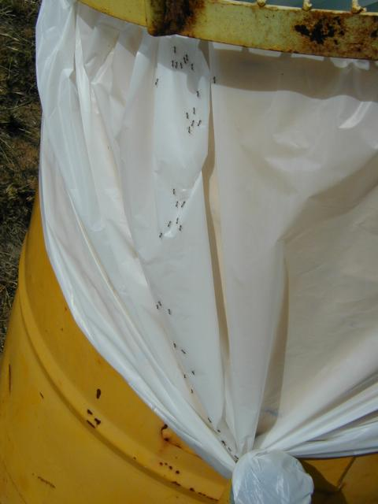
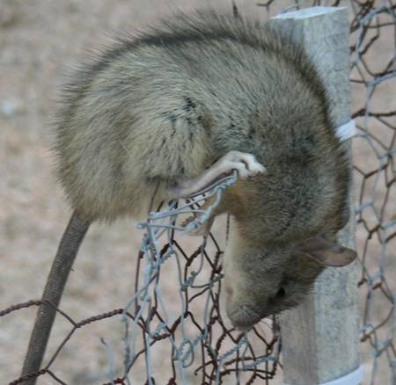
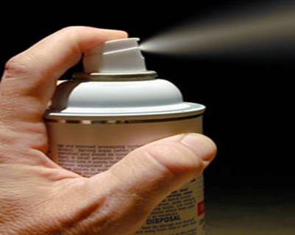
What is IPM?
A balance between pests and pesticides
An environmentally sound approach to pest control
Quality pest control using the least hazardous chemicals and techniques
Mandatory best management practice for Texas schools
Notes:
IPM is not just pest control but a way to think and react to everyday actions. IPM is about roaches, rats, ants, bats, birds, weeds and more.
IPM is also about maintaining the school building so it’s safe for teachers and students. IPM is a about people working together in effort to keep places like classrooms and the school garden free from potential pest problems. Remember an ounce of prevention is worth a pound of cure.

Slide 5
Integrated Pest Management (IPM)
Rule 7.114
A pest management strategy that relies on accurate identification and scientific knowledge of target pests, reliable monitoring methods to assess pest presence, thresholds to determine when pesticides are needed, and both preventative and corrective control measures. Under IPM, whenever economical and practical, multiple control tactics should be used to achieve best control of pests. These tactics will possibly include, but are not limited to, the judicious use of pesticides.
Notes:
This definition of IPM can be found under the Texas Administrative Code (TAC) Title 4 Agriculture, Part 1 Texas Department of Agriculture, Chapter 7 Pesticides, Subchapter H Structural Pest Control Service, Division 1. GENERAL PROVISIONS 4 TAC §7.114 Definitions.
It’s important to understand this definition as it guides how pesticides can be applied within a school IPM Program. Accurate pest identification and having pest specific thresholds will ensure that pesticide misapplication will not happen more frequently.

Slide 6

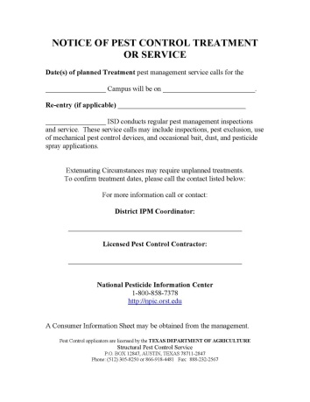
TX School IPM Law § 1951.212
Each school district shall:
  Adopt an IPM Program
  Designate an IPM Coordinator (s)
  Only use license pesticide applicators
  Post indoor applications 48 hours in advance
  Post outdoor application at time of treatment and keep posted until specified reentry is met.
Notes:
The Statutes that guide all TX public schools require that each school district comply with these laws and regulations. The basic guidelines are to have a written IPM program, have at least one school IPM coordinator, contract or hire licensed pesticide applicators to make pest control treatments, ensure that prior to all indoor pest control treatments that 48 hours in advance the area is clearly posted for building occupants and ensure that all outdoor treatments for insects and weeds are posted at the time of treatment and stay posted until the specified re-entry time has been met. Reentry times will be based on the type of product used by the licensed applicator.

Slide 7
TX School IPM Rules §7.150
The School IPM Program will contain these elements:
  A school board adopted policy – see CLB (local/legal)
  Monitoring program to determine when pests are present and to justify corrective action
  Preferential use of lower risk pesticides and the use of non-chemical control measures
  A system for keeping records
  Plan to educate and inform school employees about their role in the program
  Written guidelines that identify thresholds
Notes:
Part of the IPM program is to educate everyone in the school district about their role in the IPM program. Even teachers, custodians, food service, counselors, nurses and principals all have a role in the IPM program. The School Board adopted a policy committing the school district to follow IPM. To find a copy of this policy you can ask your district IPM coordinator, contact the Superintendent’s office, or search the online Policy Services website for the CLB (Local) policy. This policy will help you understand why only licensed applicators can make pesticide applications.
In addition to this policy the school district must also follow these following tenets.
Monitoring – prior to just spraying a pesticide, the IPM coordinator should investigate to see what type of pest is causing the problem, has it exceeded a threshold level and is there a non-chemical way to control the pest.
Treatments – in some cases the best way to control pests is to clean up the area to make inhabitable for pests to thrive. In some cases it could be fixing doors, windows, sealing up cracks or fixing ceiling tiles. In the school garden it could be using hoes and other devices to pull weeds, placing barriers or collars around plants, using netting to keep birds out, and other non-chemical measures. If a pesticide is needed, then choosing a product that is specific to that pest and is considered low-impact or in TX classifies as a Green Category under the school IPM rules is the preferred way to deal with most nuisance pest problems.

Slide 8
§7.150 School District Role
Each school district that engages in pest control activities must employ or contract with a licensed applicator, who may, if an employee, also serve as the IPM Coordinator(s).
Each school district shall prior to or by the first week of school attendance, ensure that a procedure is in place to provide prior notification of pesticide applications in accordance with this chapter. Individuals who request in writing to be notified of pesticide applications may be notified by telephonic, written or electronic methods.
  Parent notification and maintaining a registry of chemically sensitive students
Notes:
It’s important to understand that a pesticide refers to any substance or mixture of substances intended for preventing, destroying, repelling or mitigating any pest. Pesticides include insecticides (for insect control), rodenticides (for rodent control), herbicides (for weed control) and many others. Nearly all useful household and sanitation products have toxicity at some level, and pesticides are no exception. Every pesticide should be assumed to be toxic and pose some risk to people and the environment. Not all pesticides are equally dangerous, however. Pesticides are among the most thoroughly safety-tested consumer chemicals. If care is taken to follow label directions and precautions, their use should pose minimal risks.
School employees are not the only ones who need to be advised about the districts IPM program. At the beginning of each school year a notice is typically placed in the student handbook for parents to read, alerting them about the IPM program and if they want to be notified each and every time a pesticide is applied at their child's campus. Teachers need to consider this when they bring children into the garden area as well, so that you don’t unintentionally exposure a child to a pesticide that they could be allergic too.

Slide 9
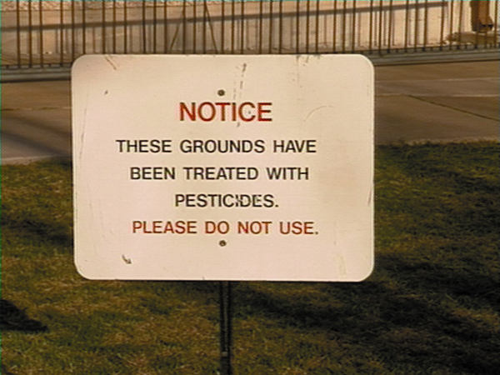


Pesticide Use In School Districts
For outdoor applications made on school district grounds, a pest control sign shall be displayed at the time of application and will remain posted until the specified reentry interval has been met in accordance with these rules.

Slide 10
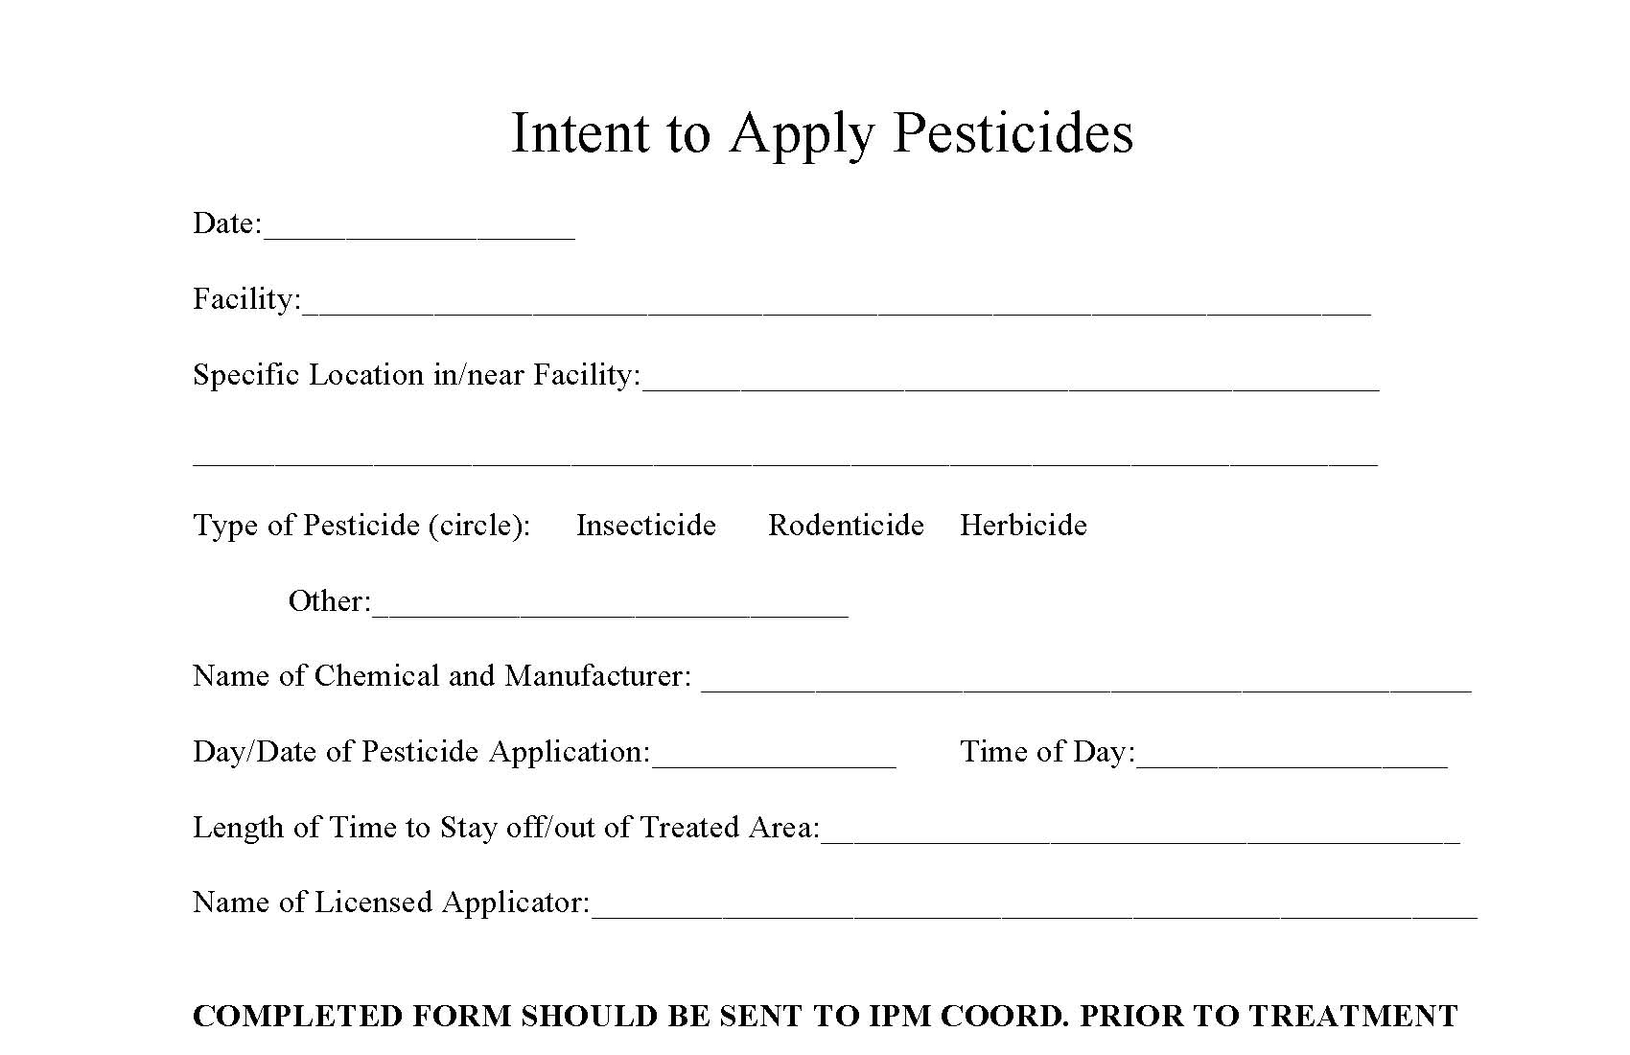
Keeping records
You cannot make applications, but you can request your Coordinator to help- use a format below to let them know what you need.

Slide 11
Garden almanac/Journal
Helps with keeping track of chores over time
Details of years weather
  Rainfall data
  Temperature
  Hours of sunlight
Sets reminders of tasks
  When to fertilize
  Plant seedlings
  Weed pulling – documenting types of weeds
  Pruning and trimming
  Installing row covers, netting or other methods to repel pests

Slide 12
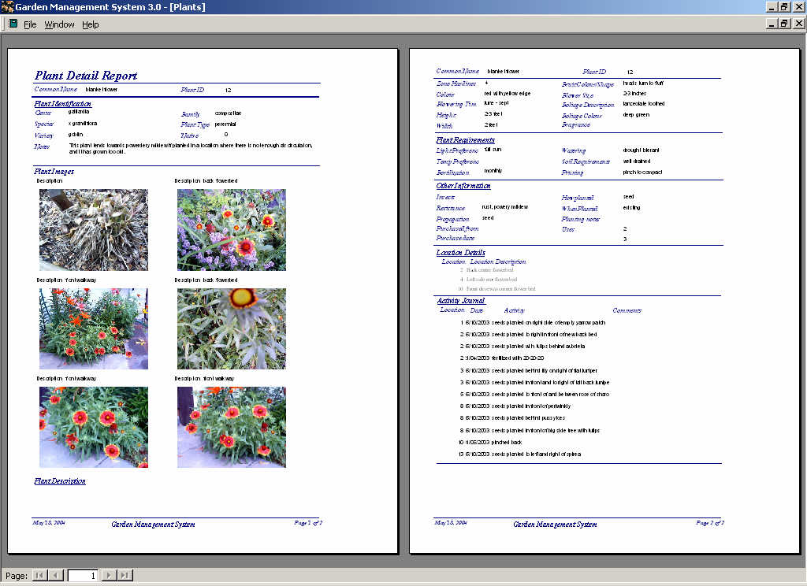
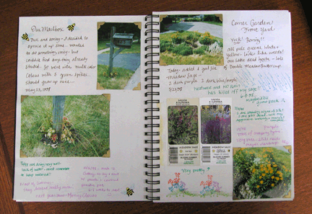

Slide 13
How YOU can help
Get to know your IPM Coordinator
Coordinate efforts
Look for resources to help defray costs of pesticide applications & supplies like shade clothe, netting, etc.
Look for volunteers who are licensed pesticide applicators
Keep detailed records
Develop parent waivers ***

Slide 14
Outline the Who’s
Who will oversee the garden area
Who will coordinate with the IPM Coordinator on pesticide applications
Who will post the area
Who will notify other school staff and students
How long is your project for
For More Information:
http://schoolipm.tamu.edu/forms/information-for-teachers-volunteers/

Slide 15
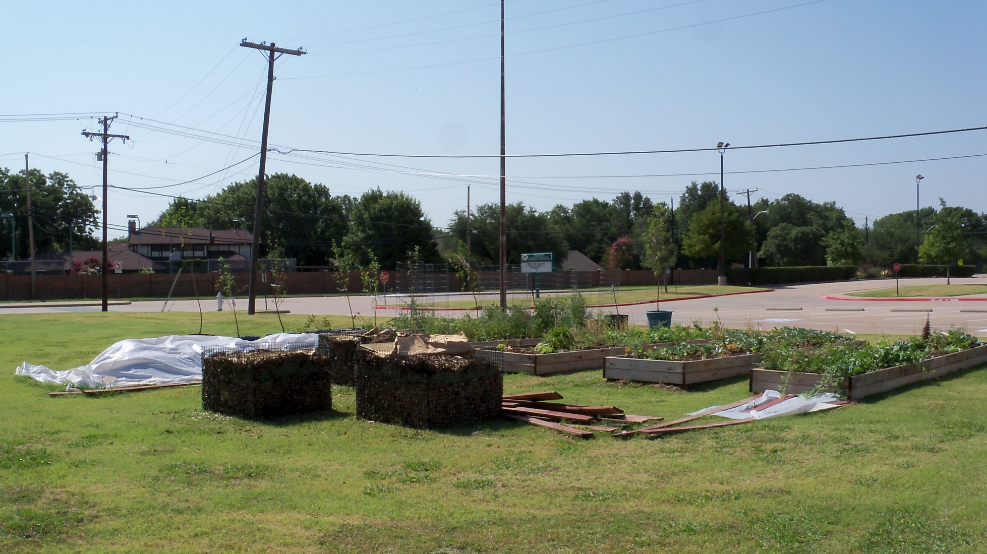
Questions

